Slide 1

Classroom Activities
Sunday Siomades & Blair Schneider

Slide 2
Grade 2
Toilet Paper Timeline
Crayon Rock Cycle
Grade 3
Renewable vs Nonrenewable
Grade 4
Rocks and the Environment
Grade 6
Critical Minerals in the World
Activities

Slide 3
Toilet Paper Timeline
Grade 2
Given a series of cards with geologic events, students must determine their chronologic order, then place each event on an accurately scaled timeline.

Slide 4
Toilet Paper Timeline
Grade 2
Course Context
Standards Met
This activity is a hands-on exercise to encourage students to apply prior knowledge of chronology to major geologic events
Can be paired with any science activity/topic that explores deep time
Science
2.ESS1.1: Use information from several sources to provide evidence that Earth events can occur quickly or slowly
Social Studies
1.3.3: Read and construct basic timelines to understand the chronology of events in history

Slide 5
Toilet Paper Timeline
Grade 2
Learning Goals
Materials
Students should be able to name major geologic events
Students should be able to number major events in correct chronologic order
Paper
Scissors
1 roll of toilet paper ([x] sheets)
Marker

Slide 6

Toilet Paper Timeline
Grade 2
Preparation
First Dinosaurs
230 million years ago
Print out one event card for each student in the classroom
Write the number of each printed event onto the toilet paper roll
Write out any extra events on the roll
Sample event card
Modified from "Toilet Paper Analogy for Geologic Time" activity

Slide 7
Toilet Paper Timeline
Grade 2
Pangea finishes forming
280 million years ago
16
Opening of Atlantic Ocean
200 million years ago
Early flowering plants
150 million years ago
First Dinosaurs
230 million years ago

Slide 8
Toilet Paper Timeline
Grade 2
Teaching Tips
Assessment
Try to complete the activity in a large, open space where the full length of the toilet paper roll can be extended
Give each student an event card and ask them to converse with each other to determine the correct order
When students have finalized the order, ask each one to read their event out loud
After completing the activity, ask students to share how they determined the position of their event
Ask students to discuss how many years are represented between events

Slide 9
Crayon Rock Cycle
Grade 2
Using crayons, students will model how the three rock types (sedimentary, igneous, and metamorphic) form.

Slide 10
Crayon Rock Cycle
Grade 2
Course Context
Standards Met
This activity is an introduction to the rock cycle and how forces such as pressure and temperature drive change between the three rock types.
Can be paired with any science activity exploring matter and how external forces influence its mutation and evolution
Science
2.PS1.3: Make observations to construct an evidence-based account of how an object made of a small set of pieces can be disassembled and made into a new object.
2.PS1.4: Construct an argument with evidence that some changes caused by heating or cooling can be reversed and some cannot.

Slide 11
Crayon Rock Cycle
Grade 2
Learning Goals
Materials
Students should be able to name the three rock types
Students should be able to explain, broadly, how each rock type forms
Students should be able to recognize pressure and heat as driving forces of rock type change
Students should be able to define Weathering, Erosion, Compaction, and Deposition
Wax crayons
Microwave
Parchment paper
Small container of cold water (shoebox-size or equivalent)
Scissors (will be used to shave the crayons)

Slide 12


Crayon Rock Cycle
Grade 2
Description
The whole crayon represents an Igneous rock
To show Weathering: shave the crayons with scissors
To show Erosion: pick up the mixed crayon shavings and move them
To show Deposition: drop the shavings in various places
To show Compaction: deposit some of the shavings onto a sheet of parchment paper, then fold the paper in half and lightly press down
Modified from "The Rock Cycle: A hands on Simulation" activity

Slide 13
Crayon Rock Cycle
Grade 2
Description
To show Sedimentary rock formation:
Press down on the parchment paper-shavings packet with more force
Peel back the paper to show how the shaving have bonded together in a lump
To show Metamorphic rock formation:
Press down on the parchment paper-shavings packet some more, then briefly stick it in the microwave
Show how the shavings have deformed and the overall shape of the shavings lump has changed
To show Igneous rock formation:
Melt the packet in the microwave for a little longer
Remove it and then submerge the package (paper and all) into your container of cold water
Modified from "The Rock Cycle: A hands on Simulation" activity

Slide 14
Toilet Paper Timeline
Grade 2
Teaching Tips
Assessment
Bonus points: make a simple paper cone (your “volcano”) with an open top, place your hand (holding crayons) under it, and toss the crayons up through the top hole to demonstrate eruption
This activity can be a demonstration or a follow-along workshop
Ask students what the initial volcano and microwave have in common (they are both powerful sources of heat)
Students should be able to match vocabulary words (Igneous, Sedimentary, Metamorphic, Compaction, Erosion, Weathering, Deposition) to their definitions

Slide 15
Renewable vs Nonrenewable
Grade 3
Students will remove and eat chocolate chips out of a cookie to simulate coal mining, and create a rover to demonstrate the power of wind energy.
Notes:
Chocolate Chip Cookie Mining Activity Plan: https://www.calacademy.org/educators/lesson-plans/fossil-fuels-chocolate-chip-mining
Wind Rover Activity Plan

Slide 16
Renewable vs Nonrenewable
Grade 3
Course Context
Standards Met
This activity is best completed after students have been introduced to sources of energy/power and where they can find them in their lives
Can be paired with science and social studies units discussing energy and natural resources
Social Studies
3.2.3: Identify the characteristics of renewable and non-renewable resources and evaluate the role of citizens in conserving natural resources
3.4.3: Examine how the development of Oklahoma’s major economic activities have contributed to the growth of the state, including, mining and energy industry, agriculture, aviation, tourism, tribal enterprises, and military installations

Slide 17
Renewable vs Nonrenewable
Grade 3
Learning Goals
Materials
Students should be able to explain the difference between a renewable and nonrenewable resource
Students should be able provide examples of renewable and nonrenewable resources
Students should be able to provide examples of how they use each type of resource in their daily lives
Cookie Mining
One cookie per student
Toothpicks
Napkins
Wind Rover
Electric fan
Bottle caps
Wooden skewers and/or plastic straws
Tape
Paper
Scissors

Slide 18
Renewable vs Nonrenewable
Grade 3
Description – Cookie Mining
Each student is given a cookie and instructed to pick out (using toothpicks) and set aside all of the chocolate chips
Students should attempt to keep the damage to the cookie at a minimum
When they have finished "extracting" the "resource", students should eat all of their chocolate chips
If that is not possible, "consume" the chips in some other way
Only AFTER the chips are gone, point out that students have no way of obtaining any more
Modified from "Fossil Fuels: Chocolate Chip Mining" activity

Slide 19
Renewable vs Nonrenewable
Grade 3
Description – Wind Rover
Provide rover building materials and give students 15-30 minutes to craft their vehicles
Set up the fan and race the vehicles to a finish line
Bracket-style eliminations, timed individual races, or both
Organize post-activity discussion
Optional: if the instructor wants to extend the activity, give students a chance to modify their designs and re-run the races
Modified from "Build a Wind-Powered Car" activity

Slide 20
Renewable vs Nonrenewable
Grade 3
Teaching Tips
Cookie Mining
Wind Rover
Encourage students to note the difference in the cookie “environment” as they mine
Does it crumble? Are there large holes? Is it possible to put the cookie exactly back to the way it was?
Share examples of coal mining in Oklahoma; a map of facilities, list ways in which coal is used in the community, etc.
Ask students if they can think of a technology in their community that uses wind (major answer: turbines)
Explain that wind is an alternative for non-renewable resources like coal

Slide 21
Renewable vs Nonrenewable
Grade 3
Assessment
Begin each activity by asking students what they think renewable and nonrenewable resources are
Ask students to think of examples (provide a list after they’ve answered)
Ask them where these resources are found
Cookie Mining: Ensure that students can answer (a) what the chocolate chips and cookie represent (b) why that resource is depletable
Wind Rover: Ensure that students can answer (a) what resource is powering their vehicle and (b) why that resource is not depletable
Can be accomplished via discussion or short answer question sheet

Slide 22
Rocks and the Environment
Grade 4
Part 1: Given a map of land environments, students will identify what types of rocks are found in which geographic areas
Part 2: Given a geologic cross-section of northern Oklahoma and fossils, students will investigate depositional environments
Notes:
Add fossil ID component using fossils in rock box

Slide 23
Rocks and the Environment
Grade 4
Course Context
Standards Met
This activity guides students through recognizing and labeling geographic features, as well as the types of sedimentary rocks and fossils that are found in specific environments
Can be paired with any lesson exploring biomes, geography (both in Oklahoma and beyond), and the rock cycle
Science
4.ESS1.1: Identify evidence from patterns in rock formations and fossils in rock layers to support an explanation for changes in a landscape over time
4.ESS2.2: Analyze and interpret data from maps to describe patterns of Earth’s features
Social Studies
4.2.3: Explain how people create regions using common geographic characteristics

Slide 24
Rocks and the Environment
Grade 4
Learning Goals
Materials
Students should be able to label types of environments
Students should be able to state which sedimentary rocks occur in which environments
Students should understand the concept of a geologic cross-section
Students should associate certain organisms with certain environments
Rock box
Printable diagrams (highly recommended: print in color)

Slide 25
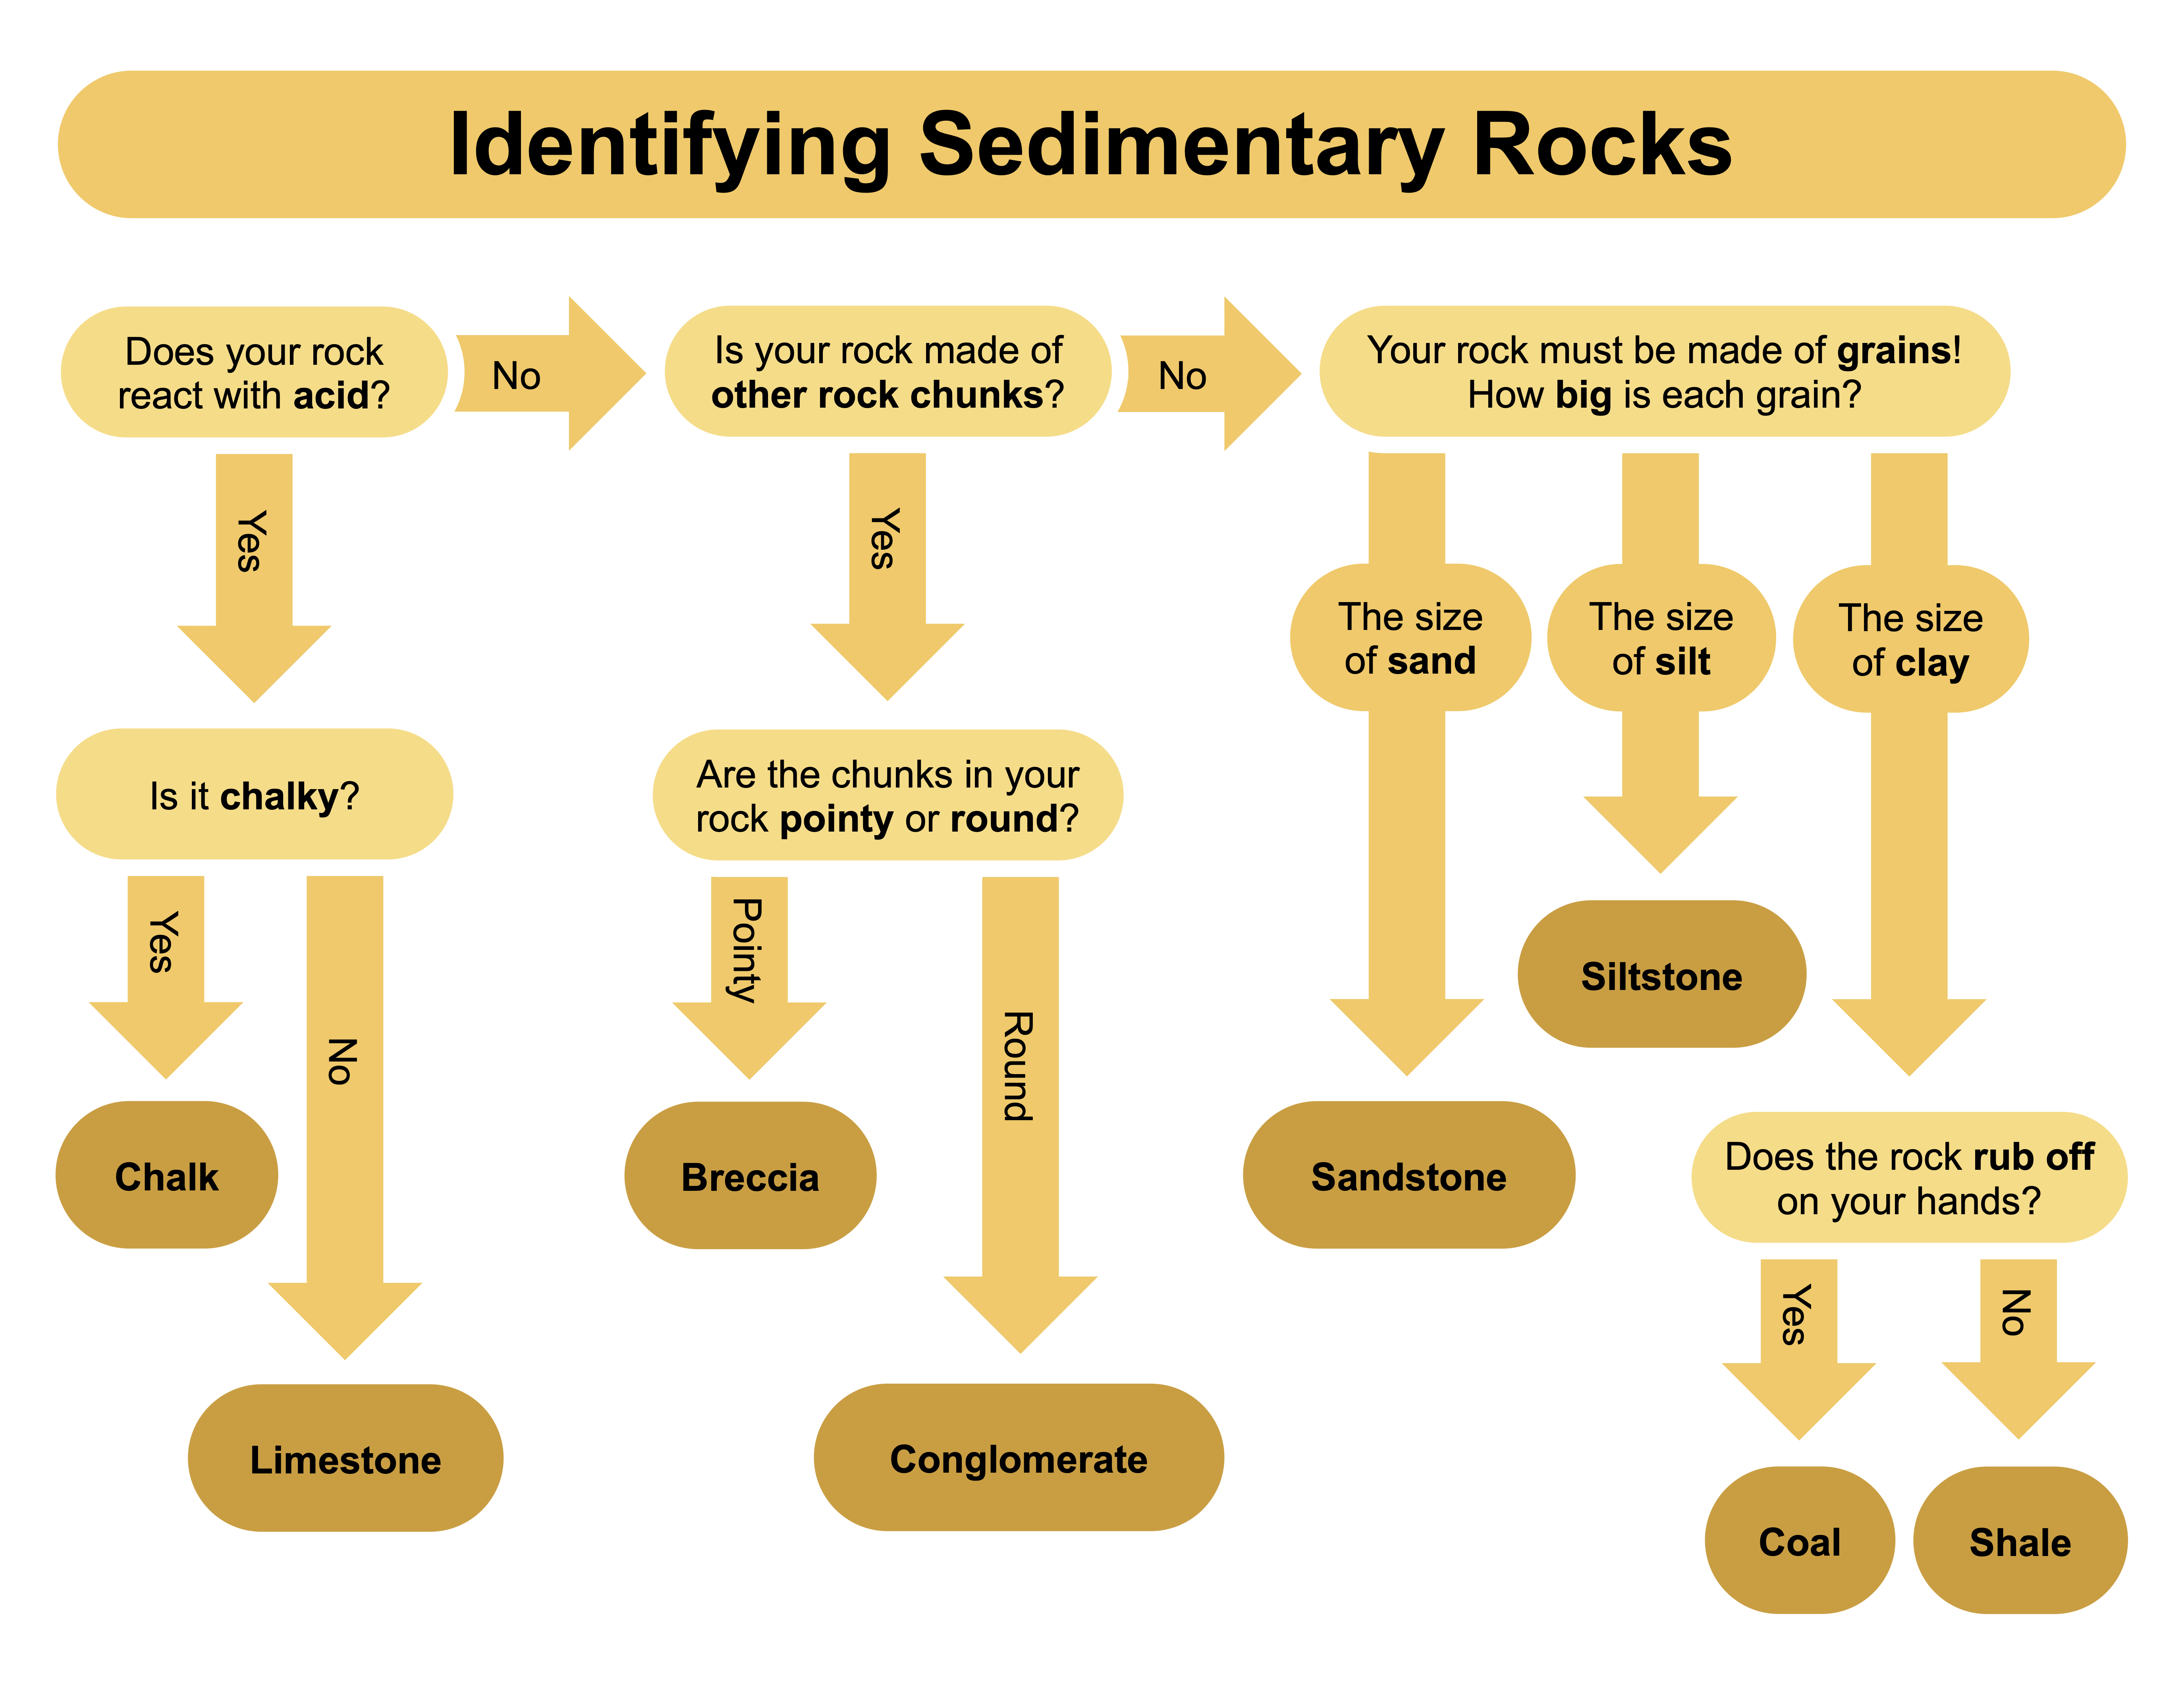

Slide 26
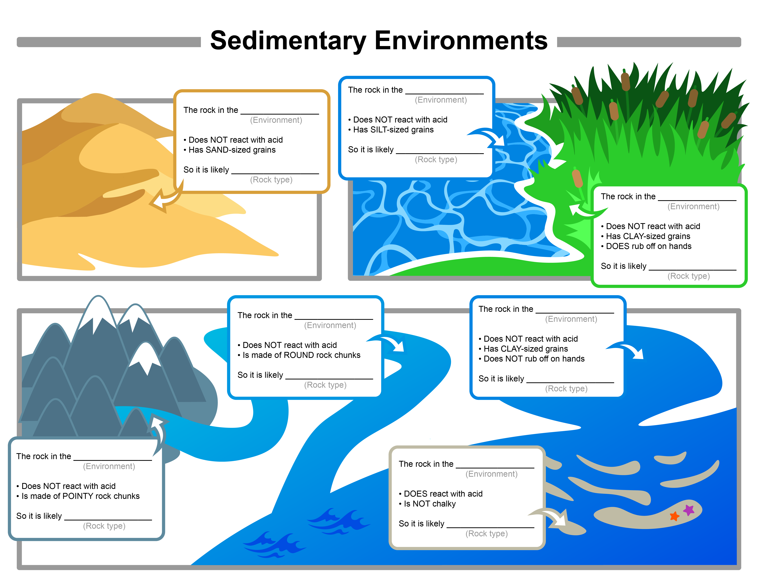
Environment
Word Bank
Desert
River
Marsh
Reef
Lake
Lagoon
Mountain River
Sedimentary Rock
Word Bank
Shale
Breccia
Sandstone
Siltstone
Limestone
Coal
Conglomerate

Slide 27
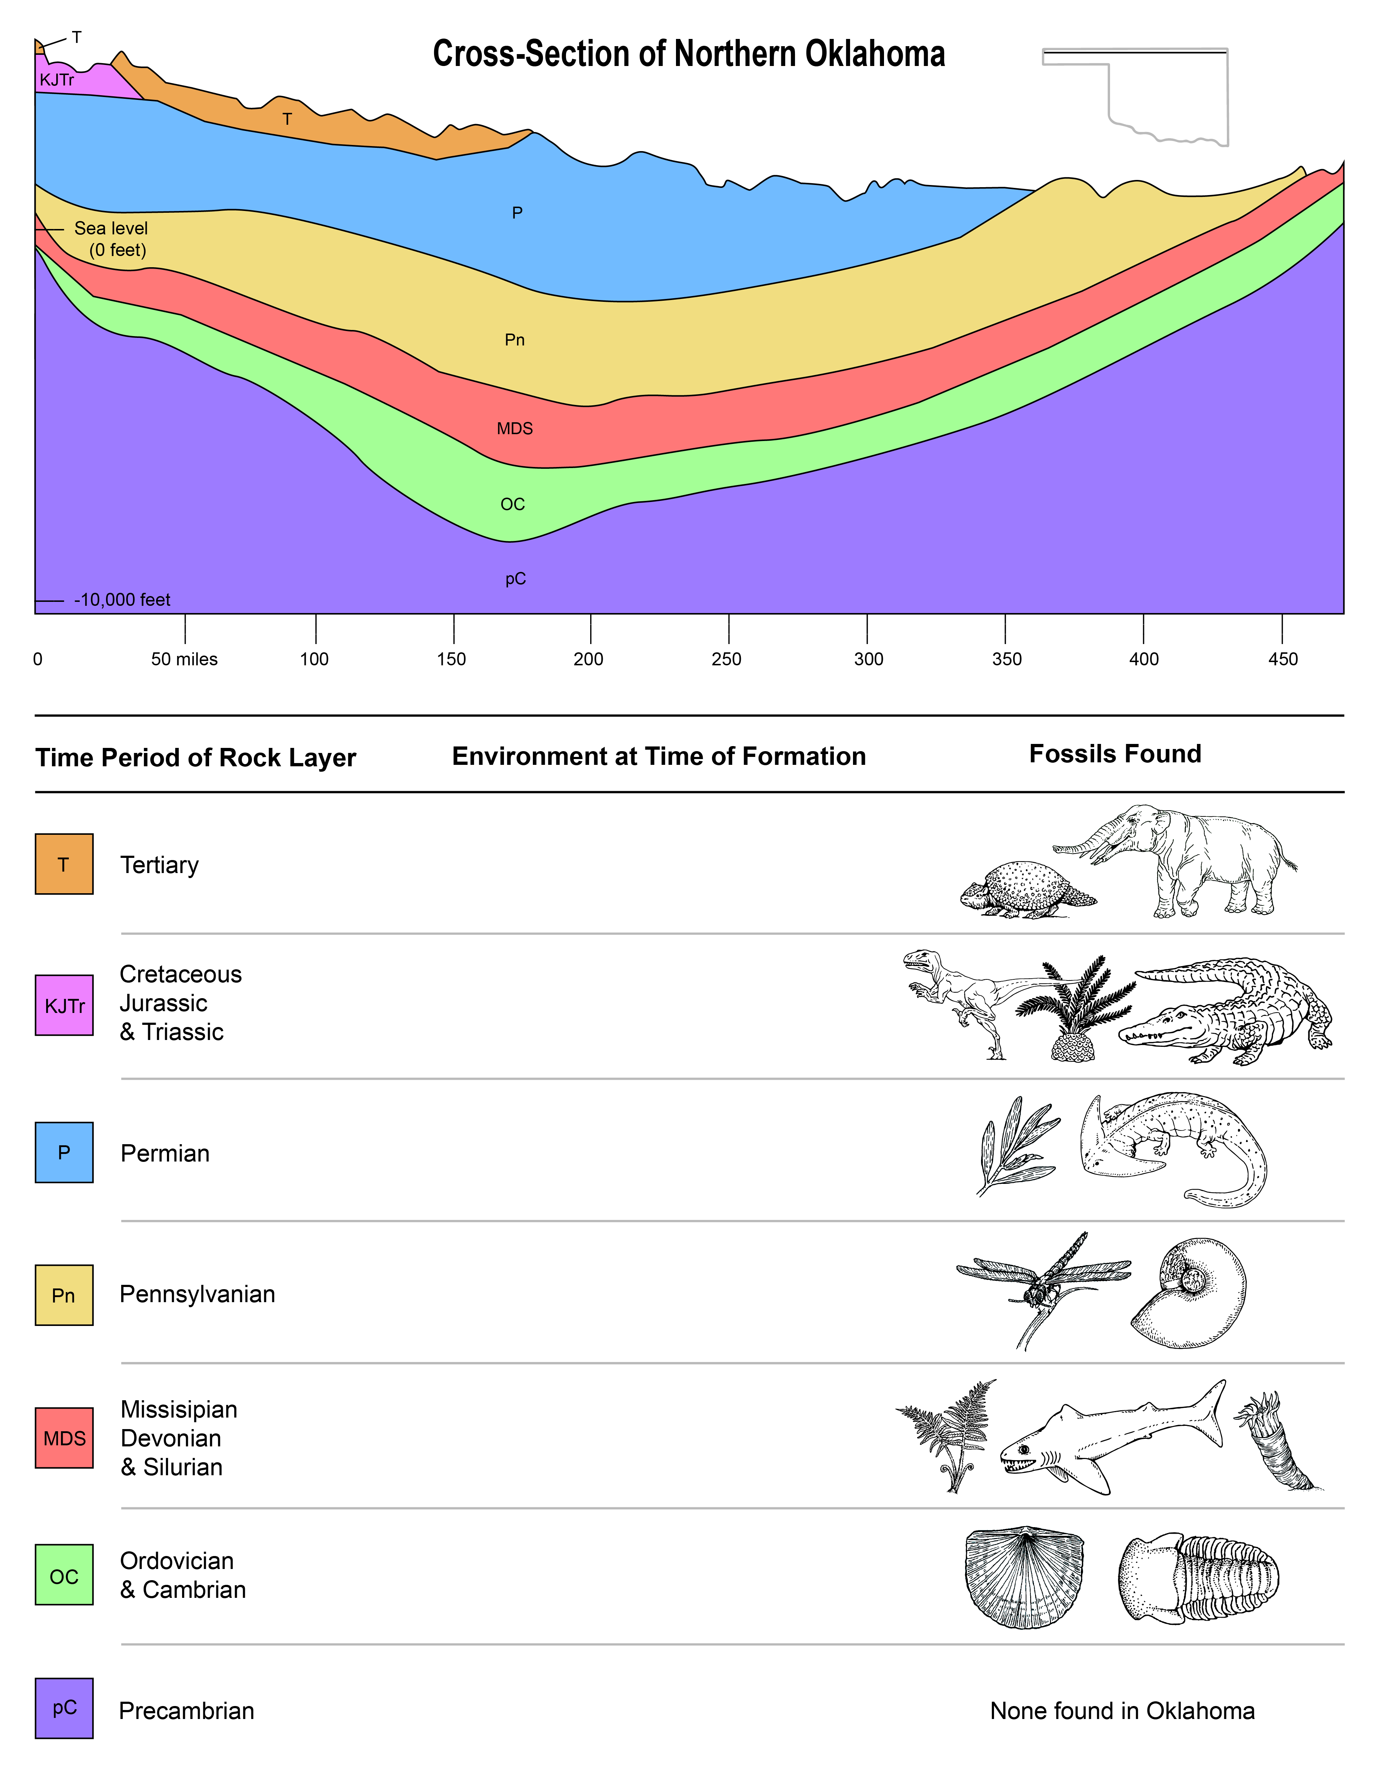

Slide 28
Rocks and the Environment
Grade 4
Teaching Tips
Assessment
It is important to distinguish that Part 1 seeks to identify where each type of rock FORMS, not necessarily identify which types of rocks can be found in those environments currently
To increase difficulty of Part 1, remove the fill-in-the-blank text and guide students through identifying the rock samples manually
Part 1: Students should have a completed environment sheet showing where each rock type can be found
Part 2: Students should have a completed cross-section sheet showing what the Oklahoma environment was like when each layer of rock formed

Slide 29
Critical Minerals in the World
Grade 6
Given a map of the world, students will identify where major sources of critical minerals are located

Slide 30
Critical Minerals in the World
Grade 6
Course Context
Standards Met
This activity defines and identifies critical minerals
Can be paired with any science lesson exploring minerals in the rock cycle, and social studies lessons exploring the distribution of natural resources in Oklahoma and around the world
Science
6.ESS2.1: Develop a model to describe the cycling of Earth’s materials and the flow of energy that drives these processes within and among Earth’s systems
Social Studies
6.2.3: Describe the predominant natural resources found in each region
6.2.4: Describe the relationship and summarize the impact of the distribution of major renewable and nonrenewable resources on each region

Slide 31
Critical Minerals in the World
Grade 6
Learning Goals
Materials
Students should be able to define a mineral, and a critical mineral
Students should be able to identify where in the world critical minerals come from
Students should be able to answer why critical minerals are often found in conjunction with coal seams
Stickers or magnets (many different colors/shapes)
Large paper (optional)

Slide 32
Critical Minerals in the World
Grade 6
Description
Introduce minerals, reference prior lessons on resources
Emphasize that the technologies we employ to make any given resource useable require special nonrenewable resources: critical minerals
Present cell phones as an example of a technology that relies on critical minerals
Have students list everything phones can do (take pictures, access the internet, etc.), and then ask them to consider what goes into the phone to allow it to do those things

Slide 33
Critical Minerals in the World
Grade 6
Description
Phone Component | Example of Critical Mineral Needed | Major Sources
Electrical circuitry | Gold | China, Australia, United States, Russia
Casing | Magnesium (compounds) | China, Russia, Turkey, Austria
Amplifier/Receiver | Gallium | China, Germany, Kazakhstan, Ukraine
LCD screen | Indium | China, Canada, Japan, Republic of Korea
Modified from Minerals Education Coalition "Cell Phone Minerals" activity

Slide 34
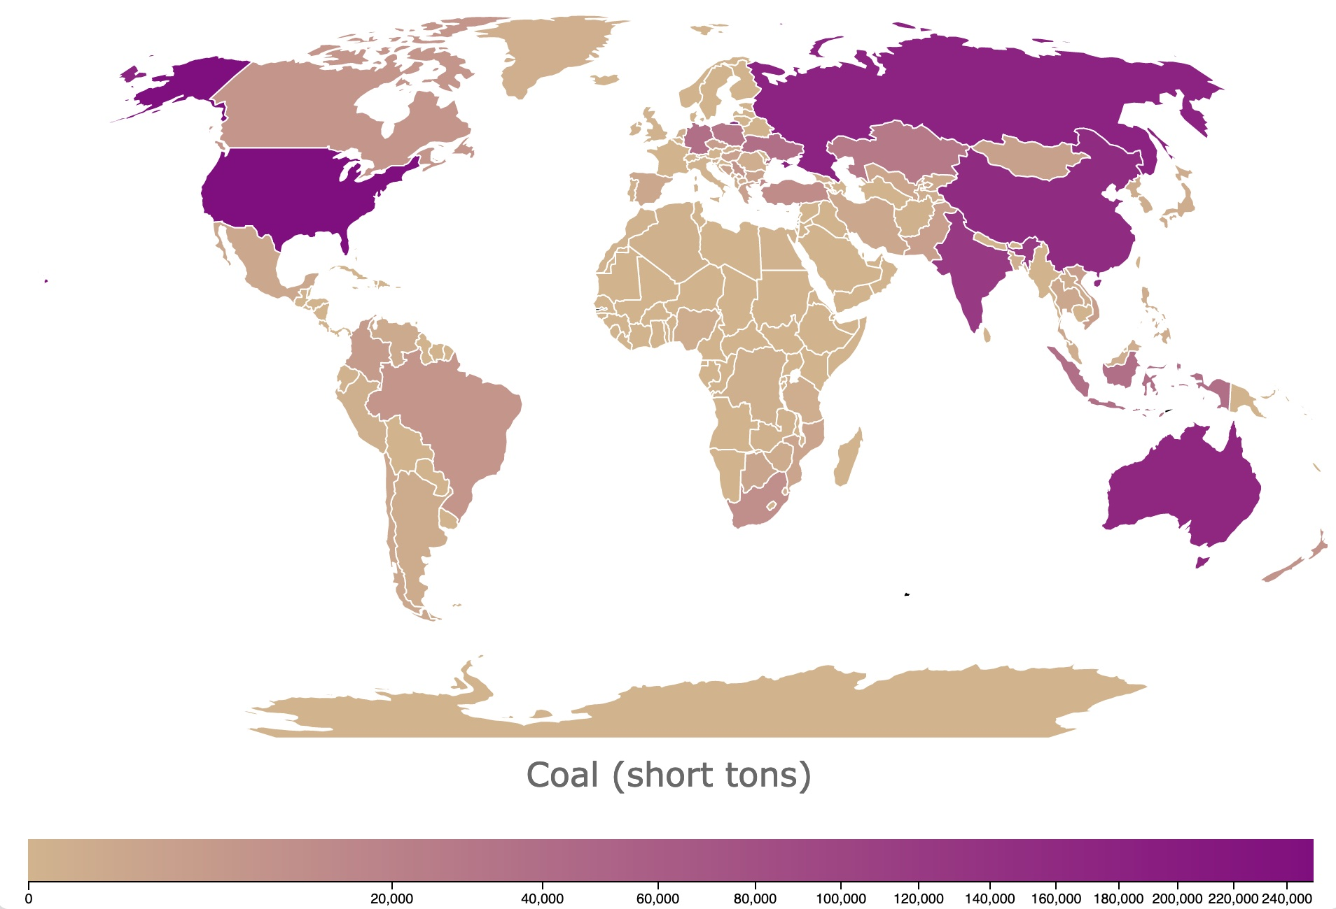
Critical Mineral | Icon | Major Sources
Gold | • | China, Australia, United States, Russia
Magnesium | • | China, Russia, Turkey, Austria
Gallium | • | China, Germany, Kazakhstan, Ukraine
Indium | • | China, Canada, Japan, Republic of Korea
Notes:
Map: https://databayou.com/coal/world.html

Slide 35
Critical Minerals in the World
Grade 6
Teaching Tips
Assessment
Also try: projecting the coal deposit world map onto the wall and tracing it onto a large sheet of paper
Or forego the paper entirely, project the map onto a whiteboard, and give students magnets instead of stickers
If the instructor has more students than unique critical minerals, assign more than one student to a mineral and ask them to work together to identify their mineral origin countries
Ask students to comment on which countries provide the most critical minerals to the U.S. (for mobile devices)
Do students notice a pattern in the source countries?
Critical minerals often appear in conjunction with coal deposits
Why do students think that is?
The coal seams themselves often contain the critical minerals. Emphasize that this is why coal is so important and desirable on the global market

Slide 36
Questions

