Slide 1


An Introduction to
Minerals

Slide 2
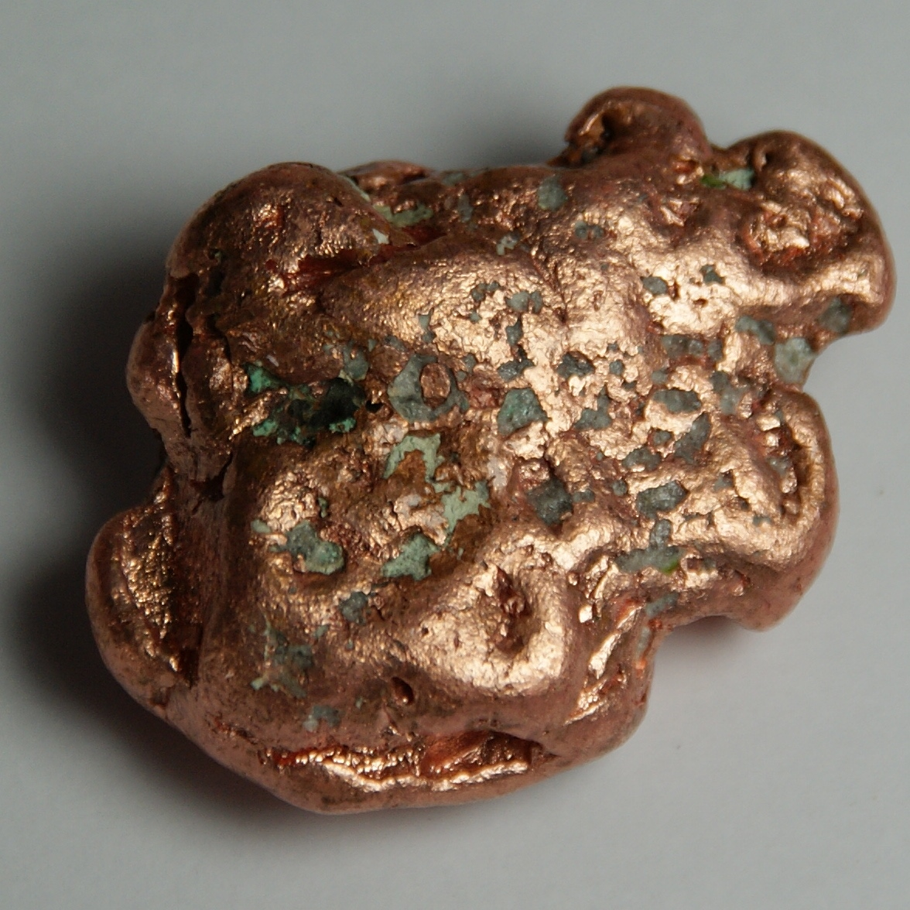
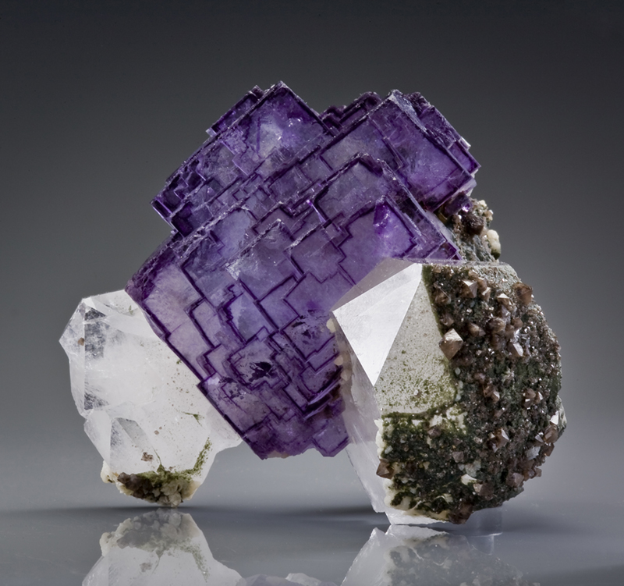
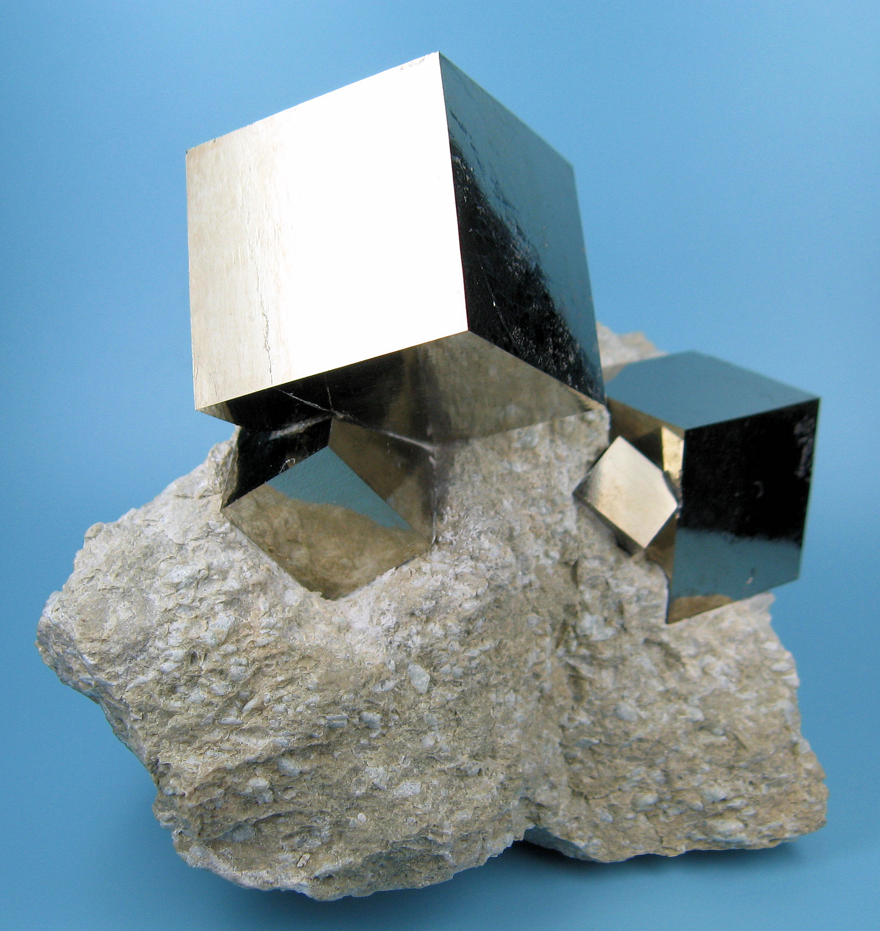
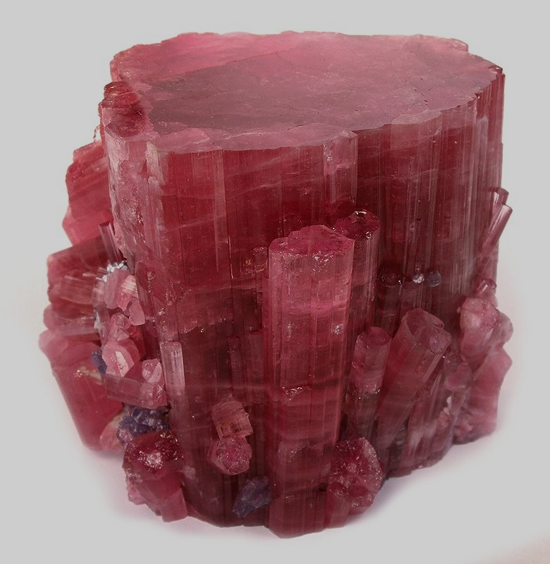
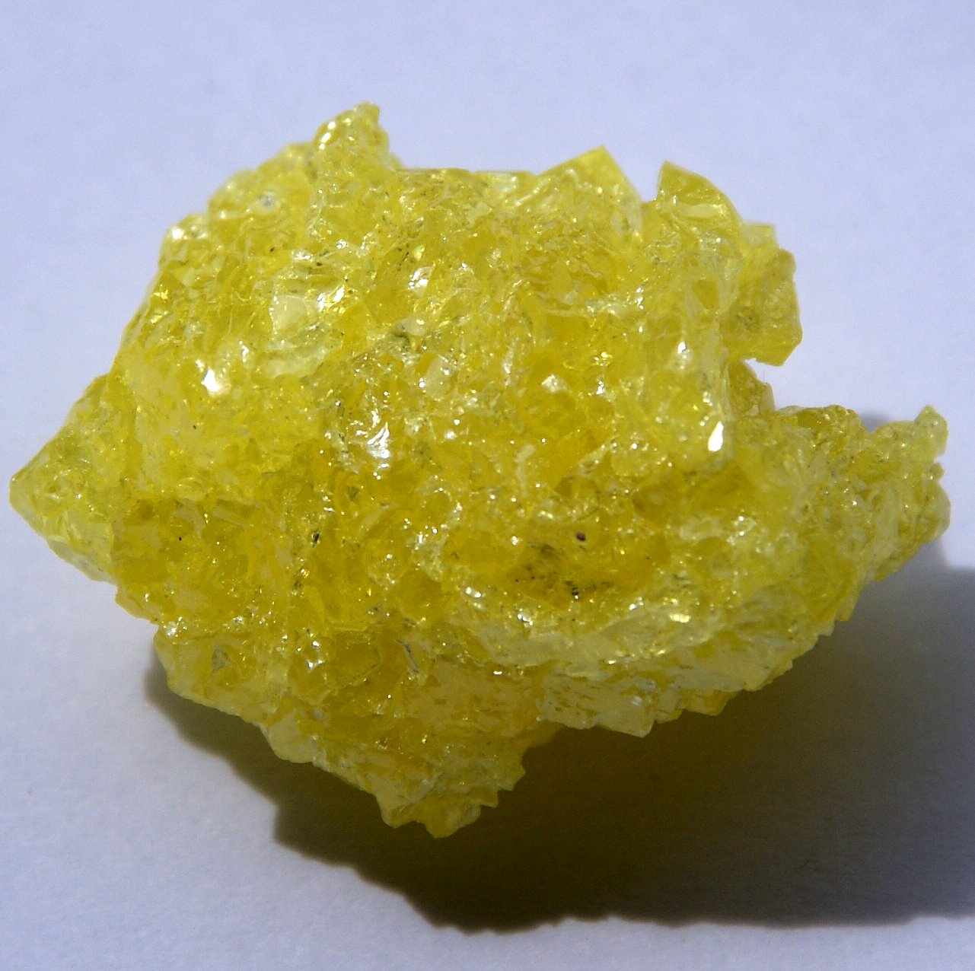
Requirements to be a Mineral
Naturally occurring
Inorganic
Solid
Crystalline structure
Characteristic chemical composition
Distinctive physical properties
Copper
Fluorite
Pyrite
Tourmaline
Sulfur

Slide 3
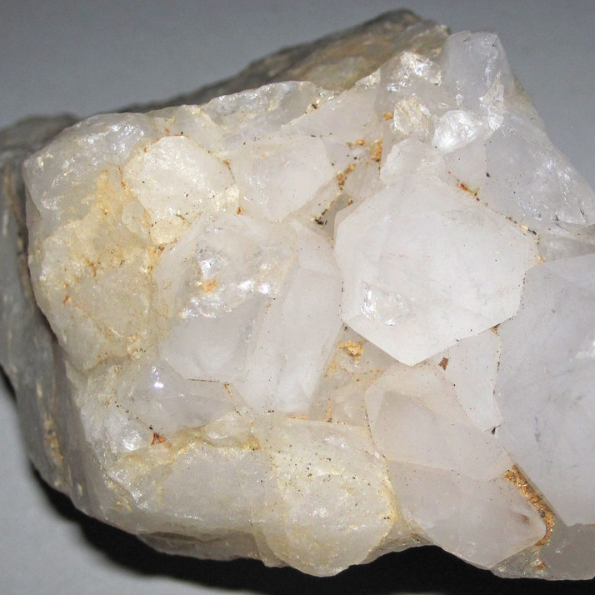
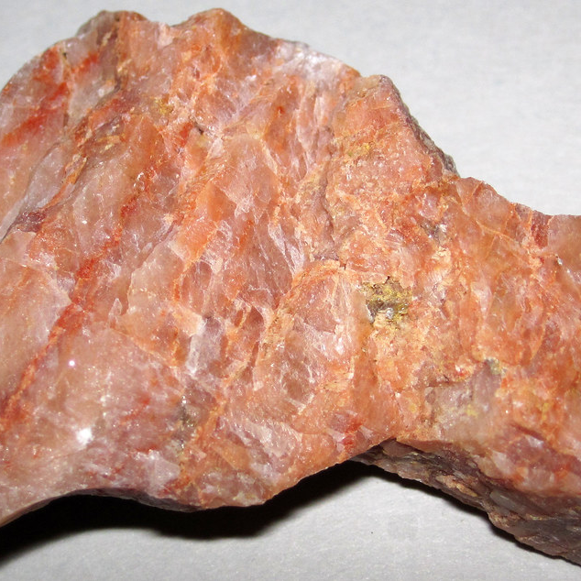
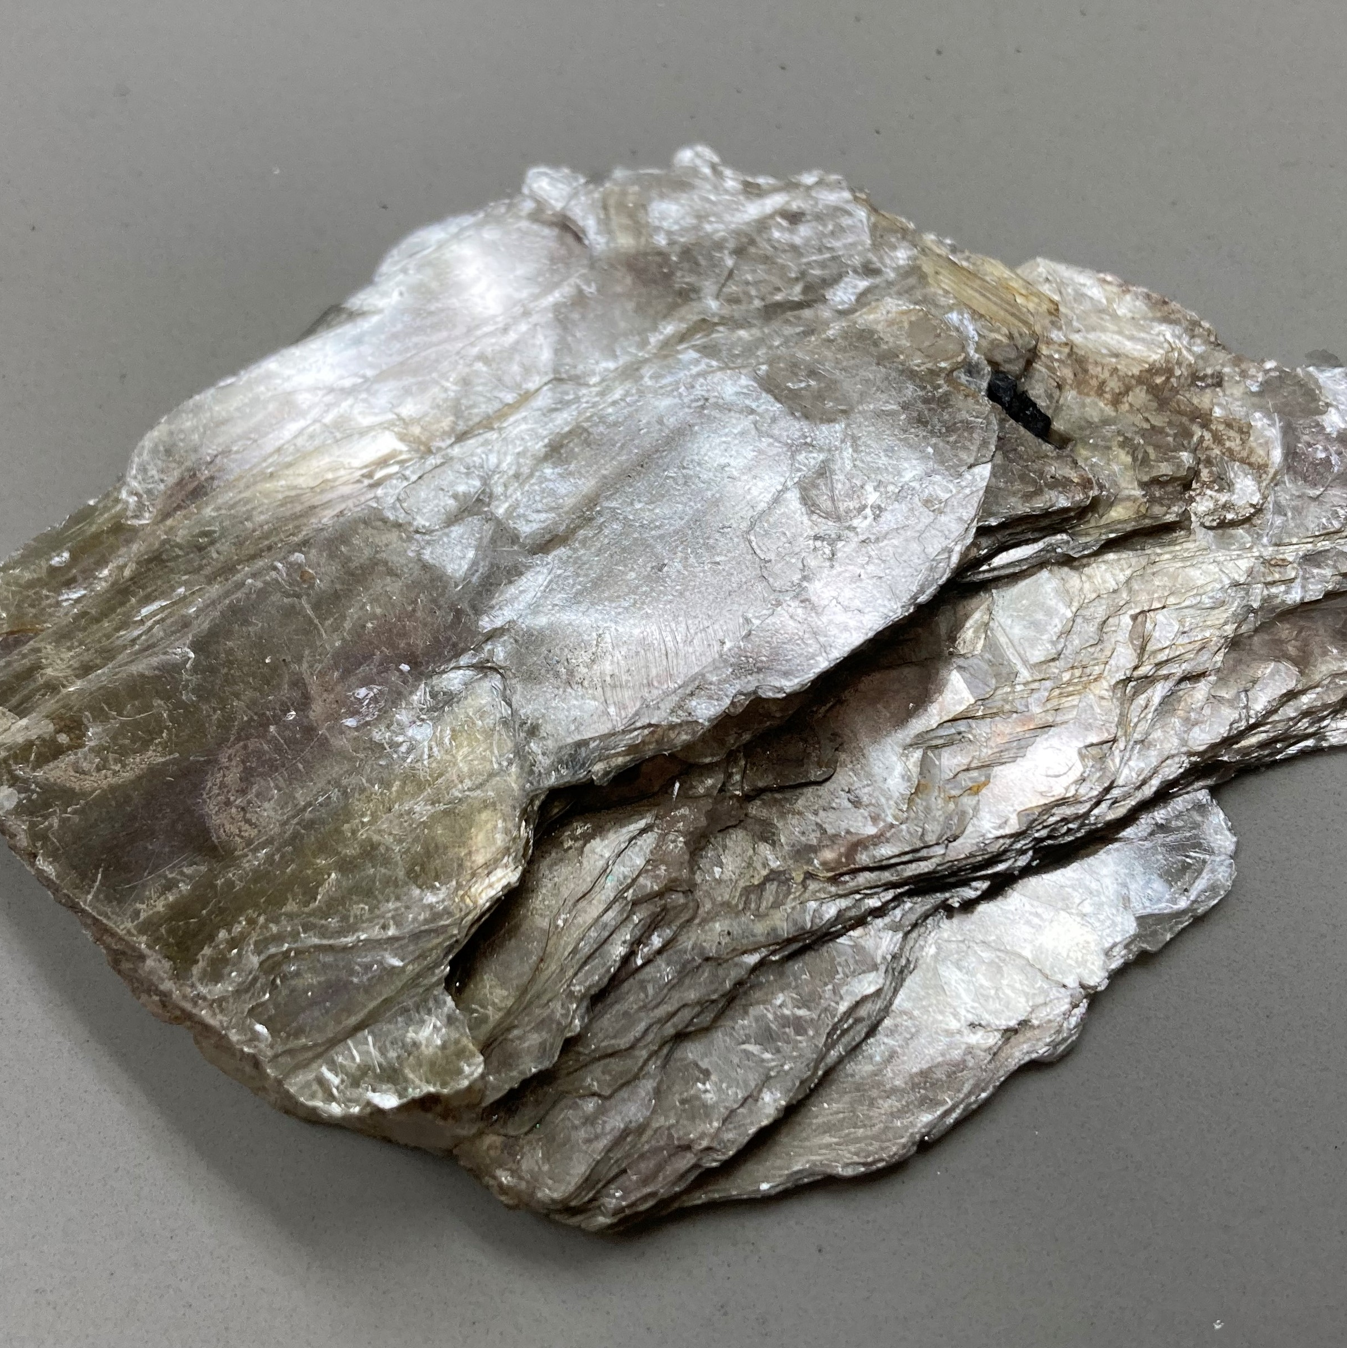
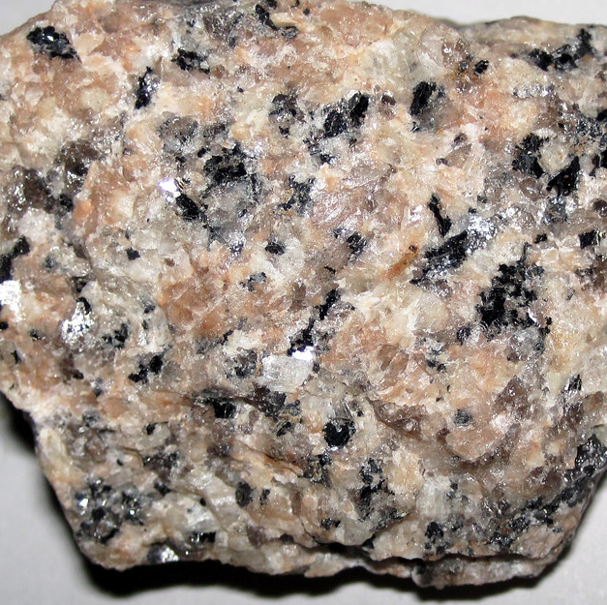
Rocks are Made of Minerals
Rocks are aggregates (combinations) of one or more minerals
Quartz
Feldspar
Mica
Granite
Minerals
Rock

Slide 4
Why Do We Care?
Minerals are in everything: furniture, appliances, jewelry, hardware, toiletries, etc.
Minerals in Your House
Minerals also make up the physical factory machinery
Notes:
https://min4kids.org/minerals-your-house/

Slide 5
Limited Resources
Minerals are consumed by industry faster than the Earth can create deposits
  New mineral deposits are continuously being formed by the Earth, but it may be millions of years before they’re in a usable form
As a result, minerals are classified as nonrenewable resources: there is a finite quantity available for humans to use
Notes:
https://min4kids.org/minerals-your-house/

Slide 6
Properties of Minerals
A mineral can be identified by its specific properties
Crystalline Structure
Crystal Form (Habit)
Color and Clarity
Cleavage
Fracture
Luster
Streak
Hardness

Slide 7
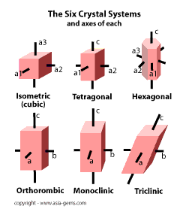
Crystalline Structure
An orderly 3D arrangement of atoms and molecules that form a crystal
Isometric (Cubic)
Three equal axes; all perpendicular
Tetragonal
Two equal axes; all perpendicular
Orthorhombic
Three unequal axes; all perpendicular
Monoclinic
Three unequal axes; only one is perpendicular
Triclinic
Three unequal axes; none are perpendicular
Hexagonal
Has a hexagon-shaped plane
The Six Crystal Systems

Slide 8
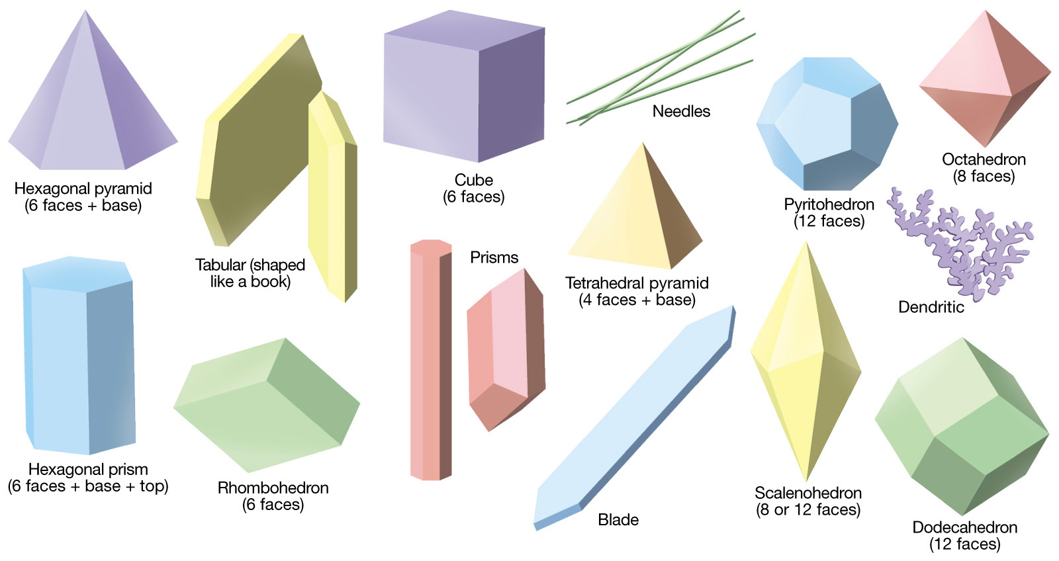
Crystal Form (Habit)
The shape of the mineral if it were allowed to grow unrestricted
Controlled by the crystalline structure
Many minerals have more than one crystal form
Notes:
Kathiresan, Palanivel. (2018). e_Learning/Reading Material on CRYSTALLOGRAPHY AND MINERALOGY - Paper Code MTIGT0306 - 6 Year Integrated M.Tech. Geological Technology and Geoinformatics being offered in CENTRE FOR REMOTE SENSING, Bharathidasan University, Tiruchirappalli-620 023.

Slide 9
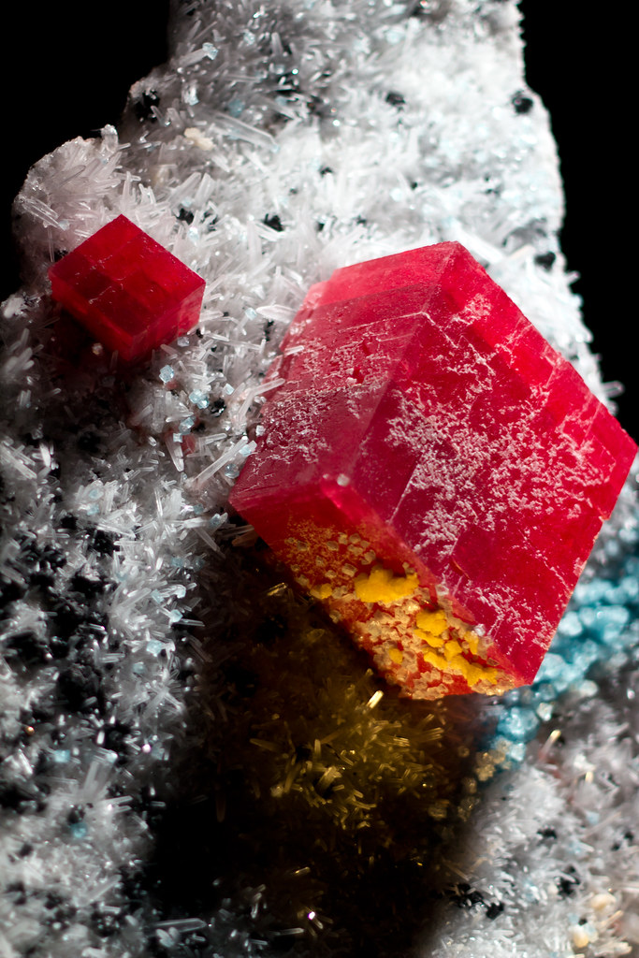
What are the crystal forms of the minerals below?

Slide 10
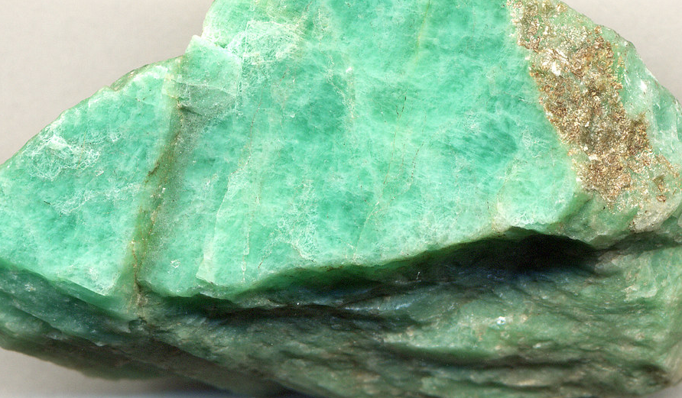
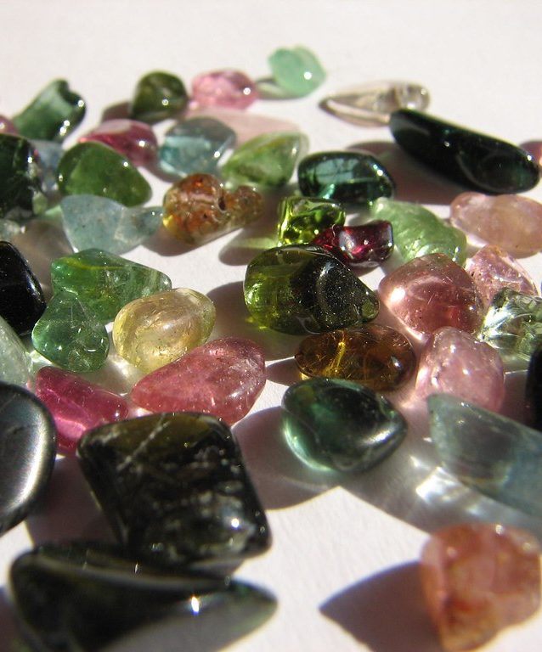
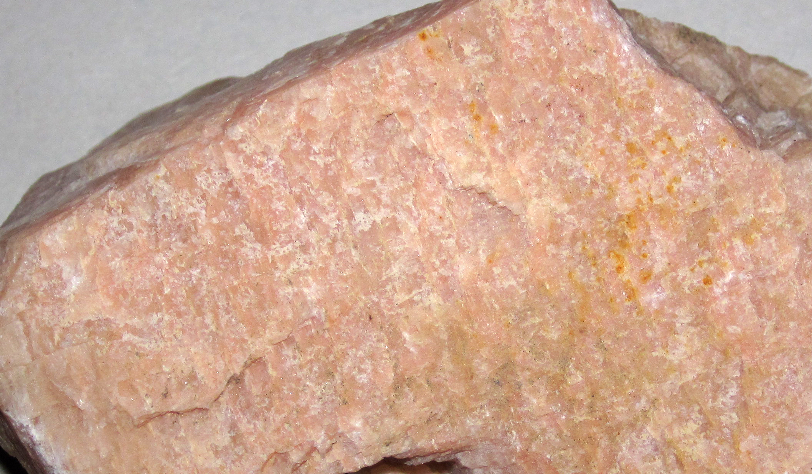
Color
Most minerals can occur in more than one color
Controlled by chemical composition
Different elemental impurities result in different colors
Green and Pink Feldspar
Tourmaline

Slide 11
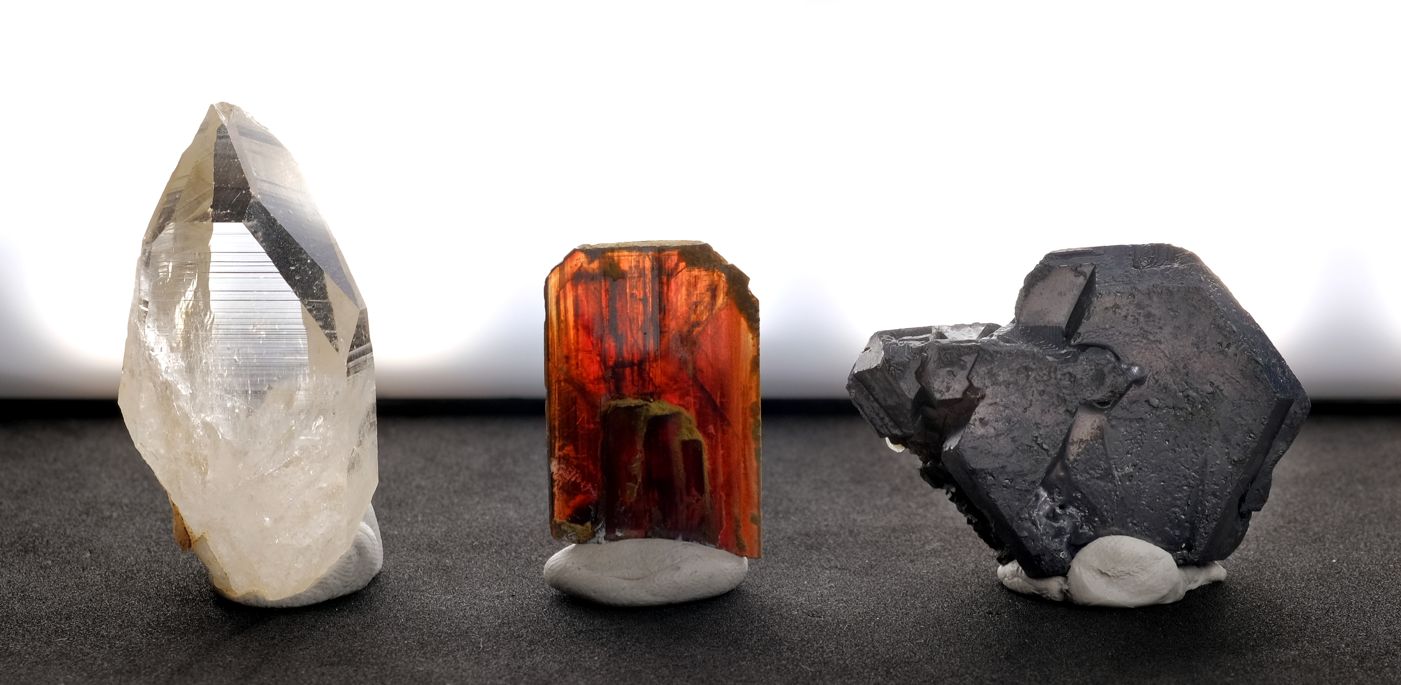
Clarity
The clearness or lucidity of the color of a mineral
Transparent
Translucent
Opaque

Slide 12
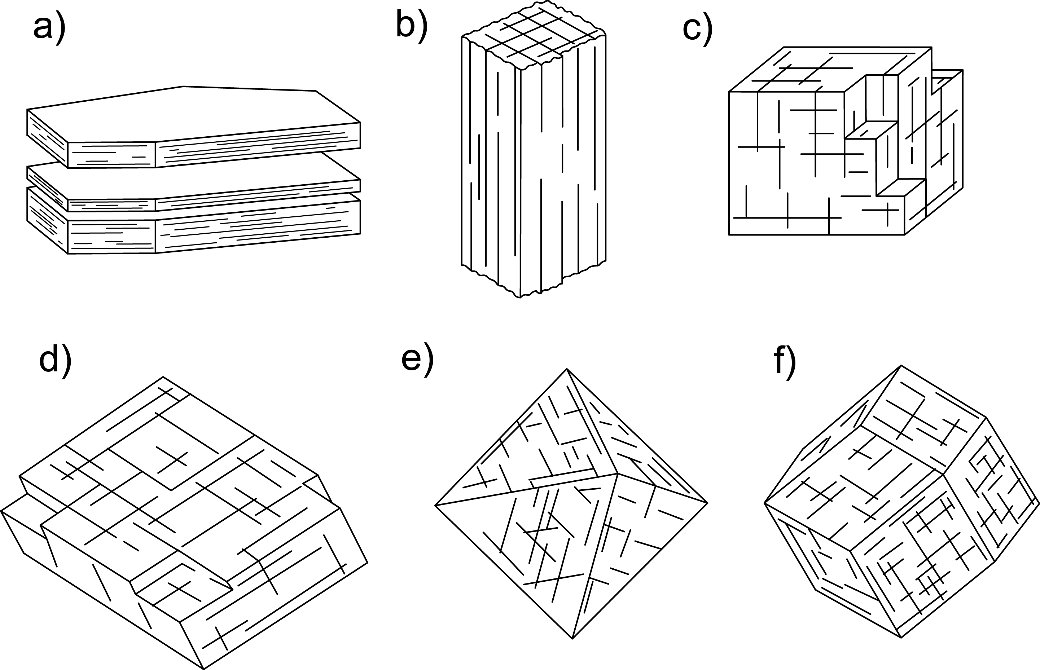
Cleavage
The tendency of a mineral to break along a plane of weakness within the crystalline structure
Basal
Prismatic
Cubic
Rombohedric
Octahedric
Dodecahedric
Cleavage Types

Slide 13
Fracture
The way a mineral breaks along irregular surfaces
Conchoidal fracture (smoothly curved like broken glass)
Irregular/uneven fracture (rough)
Splintery fracture (like wood)
Hackly fracture (jagged ends)
ALL minerals have fracture, but NOT all minerals have cleavage

Slide 14
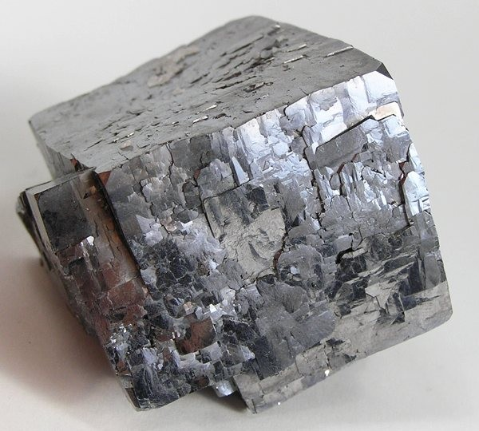
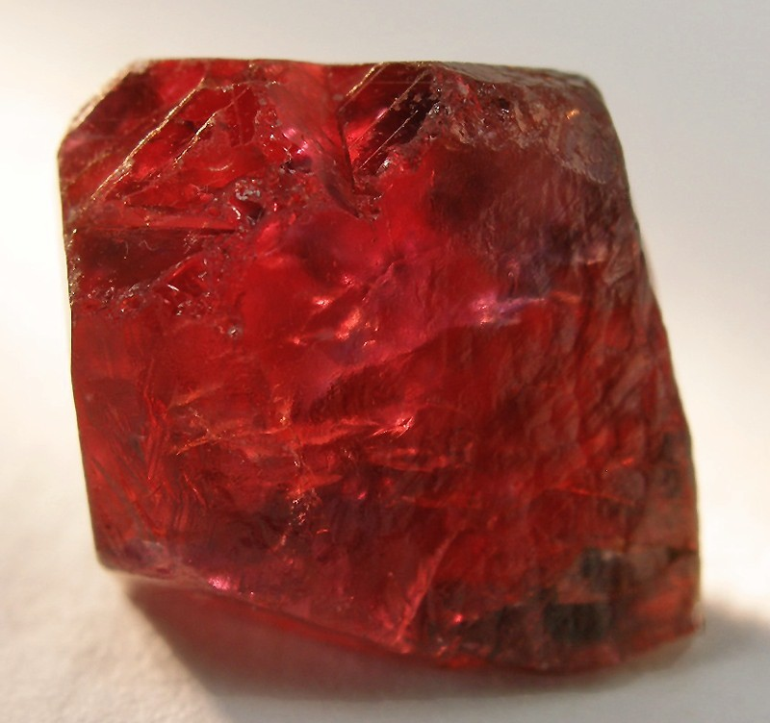
Luster
Describes how the mineral surface reflects light
Non-metallic
(does not look
like metal)
Metallic
(looks like metal)
Galena
Corundum
Non-metallic luster is described as earthy, waxy, vitreous, pearly, or silky

Slide 15
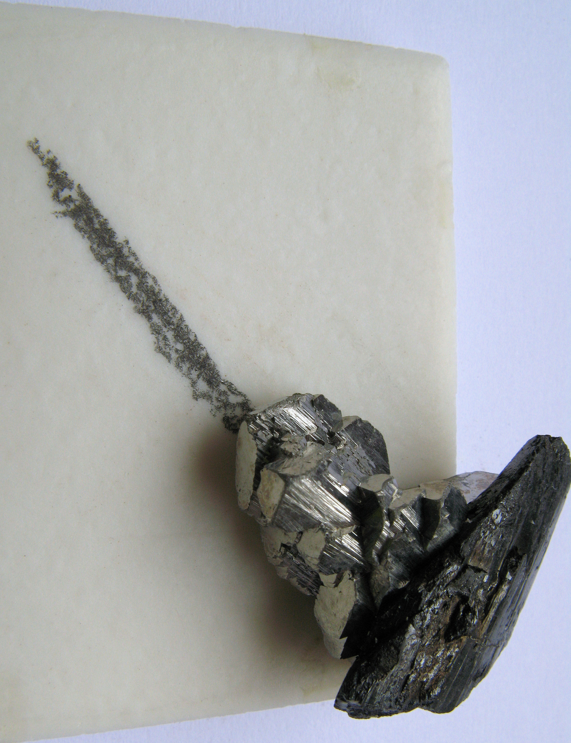
Streak
The color of a mineral after it has been ground to fine powder
The streak of a mineral shows less variation than the color of the mineral
Most minerals have only ONE streak color
White streaks are common, therefore they are NOT diagnostic
Minerals that are harder than the streak plate will not show a streak

Slide 16
Hardness
The ability of a mineral to resist abrasion
Measured using the Mohs Hardness Scale
Ranked from 1 (very soft) to 10 (very hard)
Diamonds are the hardest known mineral, and are the only naturally occurring material ranked at 10
The scale has an exponential curve
  The difference between a hardness of 8 and 9 is bigger than the difference between a hardness of 1 and 2

Slide 17
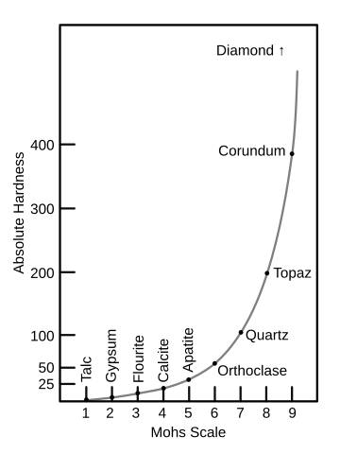
The Mohs Scale

Slide 18
Other Properties
Magnetism
Specific Gravity
Taste
Radioactivity
Fluorescence
Tenacity (resistance to breakage)
Reaction to hydrochloric acid (HCl)
Striations

Slide 19
Mineral Identification Activity
Sample # | Crystal Structure | Color | Luster (Metallic/Non-metallic) | Streak | Mineral Name
1 | Isometric | Gold | Metallic | Black | Pyrite
Can provide word bank and/or partially filled in table to decrease difficulty for lower grade levels

