Slide 1

An Introduction to
Sedimentary Rocks

Slide 2
Clast
a constituent fragment of a clastic rock
Crystal
a naturally occurring solid made up of atoms arranged in a regular repeating pattern
Grain
a mineral or rock particle, less than a few millimeters in diameter, and generally lacking well-developed crystal faces
Key Vocabulary

Slide 3
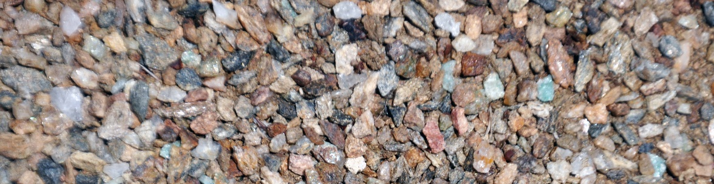
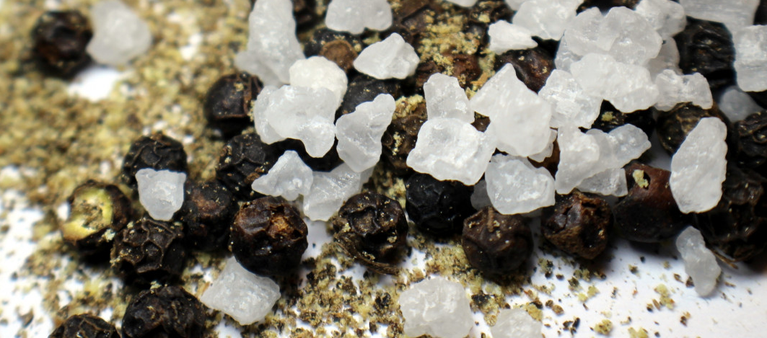
What are sediments?
Loose grains and residue of Earth materials, such as:
Rock fragments
Mineral grains
Parts of plants or animals
Halite (rock salt) grains, peppercorns, and spices

Slide 4
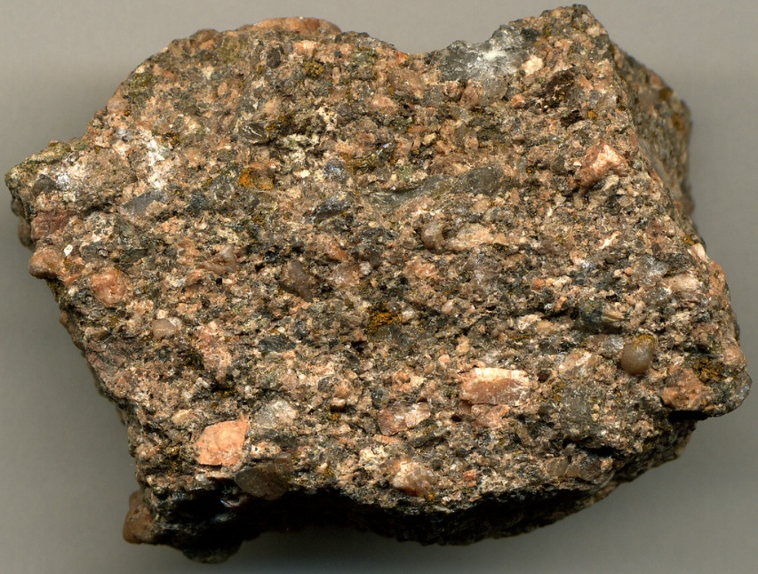
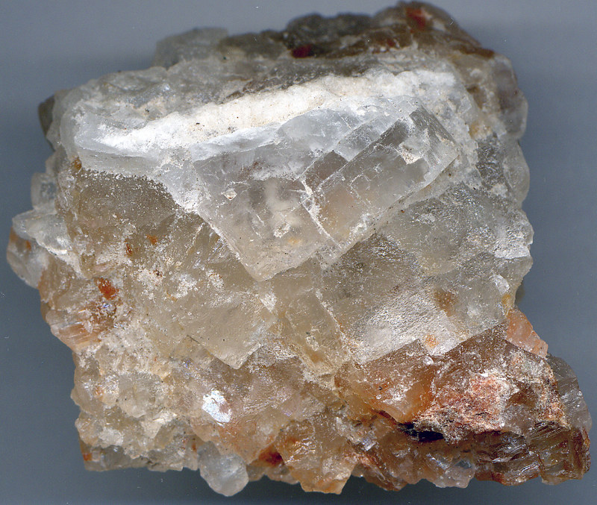
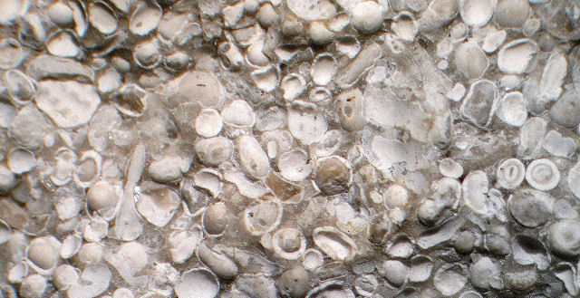
Types of Sediments
Clastic: rock fragments and mineral grains
Chemical: mineral crystals that precipitate out of aqueous solutions
Biochemical: plants and animals that have been broken up (i.e. twigs, leaves, shells, and fragmented shells)
Notes:
Arkose, rock salt, coal

Slide 5
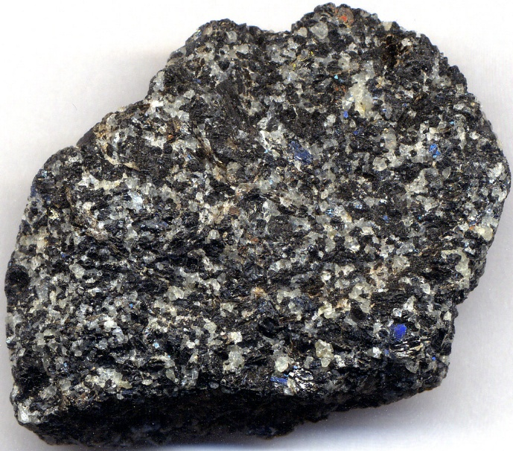
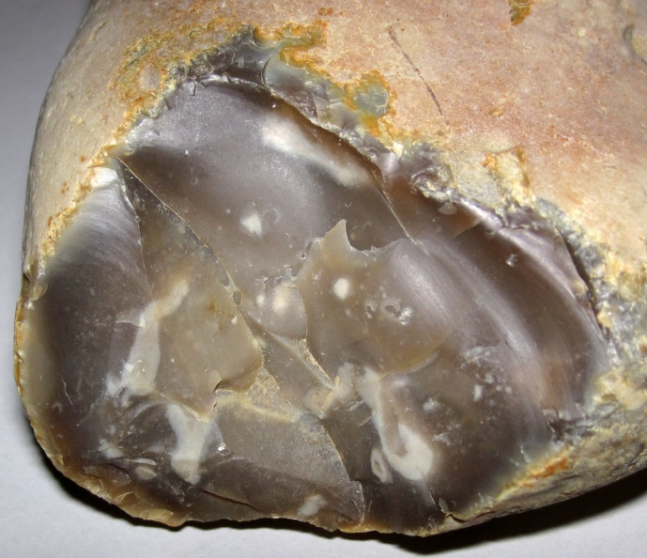
Two Types of Chemical Precipitates
Crystalline
Crystals visible to the naked eye
Microcrystalline
Crystals too small to be seen with the naked eye
Notes:
Arkose, rock salt, coal

Slide 6
Sediments are produced by weathering!
Physical/mechanical weathering
Chemical weathering
Biochemical weathering
Notes:
Arkose, rock salt, coal

Slide 7
Sediments are produced by weathering!
Physical/mechanical weathering is the breakdown of rocks and minerals by fracturing, crushing, abrasion, or other physical processes that produce clasts
Example: frost wedging
Water fills crack in rock
Rock breaks under pressure
Water freezes and expands
Notes:
Arkose, rock salt, coal

Slide 8
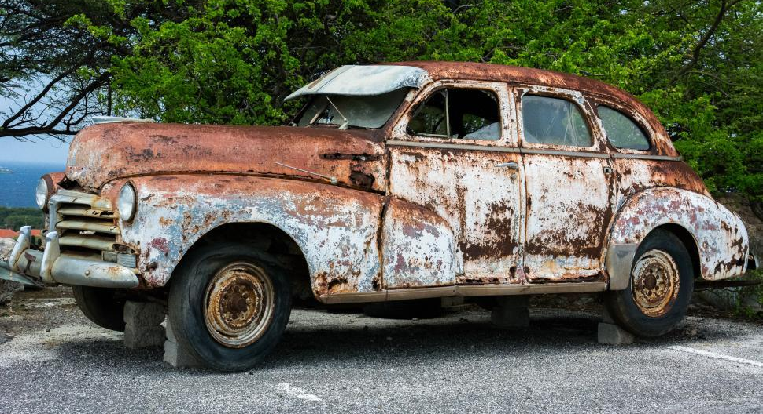
Sediments are produced by weathering!
Chemical weathering is the decomposition or dissolution of rocks and minerals
Example: rust
Notes:
Arkose, rock salt, coal

Slide 9
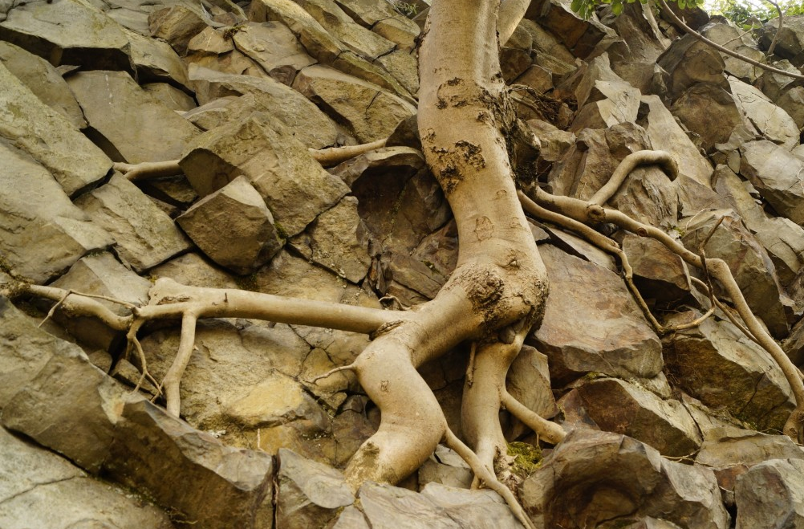
Sediments are produced by weathering!
Biochemical weathering is the breakdown of rocks and minerals by plants and animals
Example: plant roots breaking up rocks
Notes:
Arkose, rock salt, coal

Slide 10
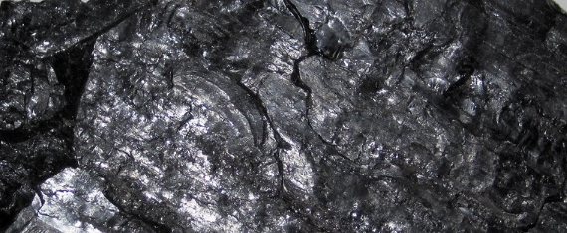
Three Types of Sedimentary Rock
Sediments become sedimentary rock when they are buried and cement together under pressure
Clastic (Detrital)
Chemical
Biochemical
Arkose
Halite
Coal
Notes:
Arkose, rock salt, coal

Slide 11
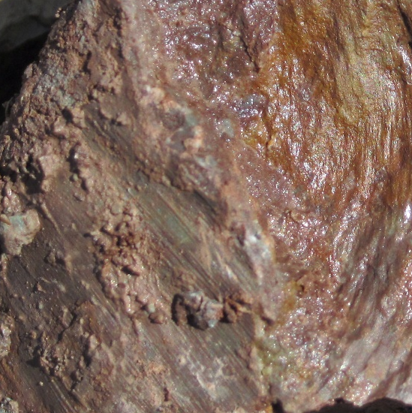
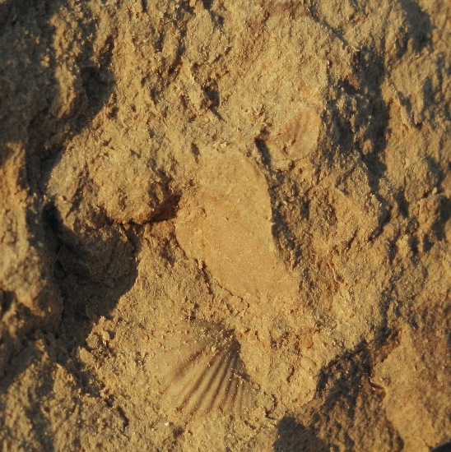
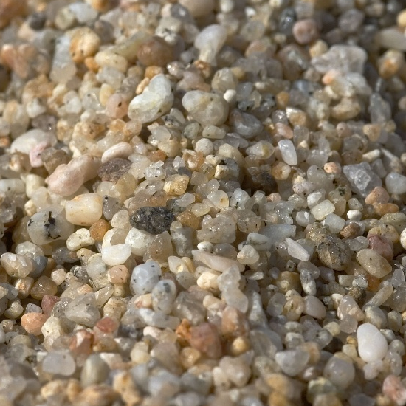
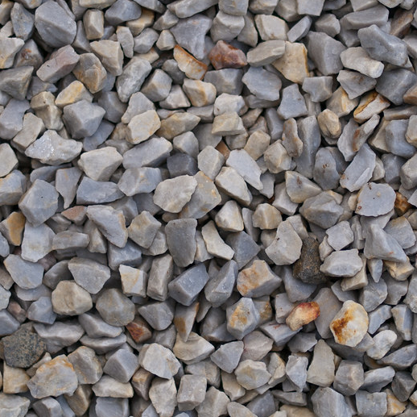
Clastic Textures: Grain Size
Clay
< 1/256 mm in diameter
Silt
1/256 to 1/16 mm in diameter
Sand
1/16 to 2 mm in diameter
Gravel
> 2 mm in diameter
Notes:
Arkose, rock salt, coal

Slide 12
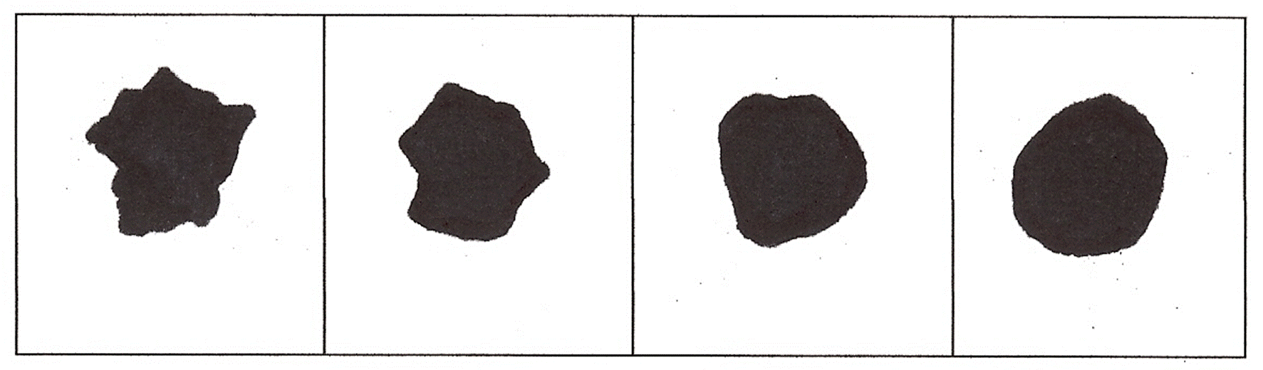
Clastic Textures: Grain Shape
Angular
Sub-angular
Sub-rounded
Rounded
Notes:
Arkose, rock salt, coal

Slide 13
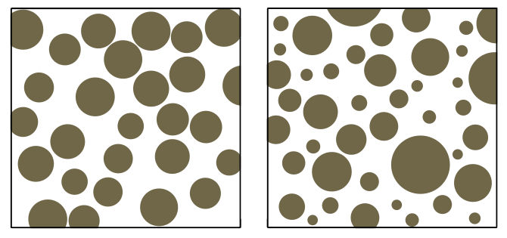
Clastic Textures: Grain Sorting
Well-sorted
Grains are all about the same size
Poorly sorted
Grains are many different sizes
Notes:
Arkose, rock salt, coal

Slide 14
Grains are…
Large, angular, poorly sorted
Grains & Energy
High Energy Environment
Grains are…
Smaller, rounder, better sorted
Mid-Energy Environment
Grains are…
Very small, very round, very well sorted
Low Energy Environment
Notes:
Arkose, rock salt, coal

Slide 15
Grains & Energy
Wind & water can carry heavy sediments
High Energy Environment
Wind & water can only carry light sediments
Low Energy Environment
Notes:
Arkose, rock salt, coal

Slide 16
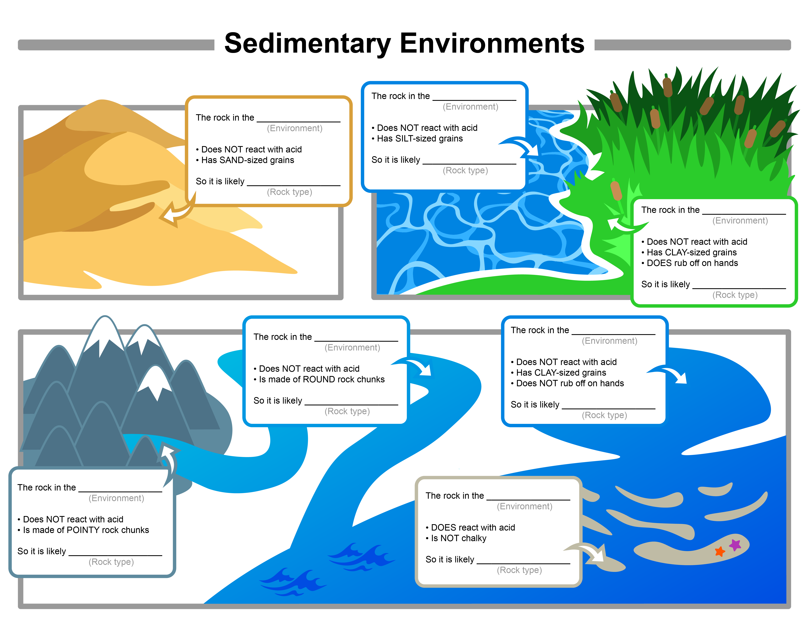
Environment
Word Bank
Desert
River
Marsh
Reef
Lake
Lagoon
Mountain River
Sedimentary Rock
Word Bank
Shale
Breccia
Sandstone
Siltstone
Limestone
Coal
Conglomerate

Slide 17
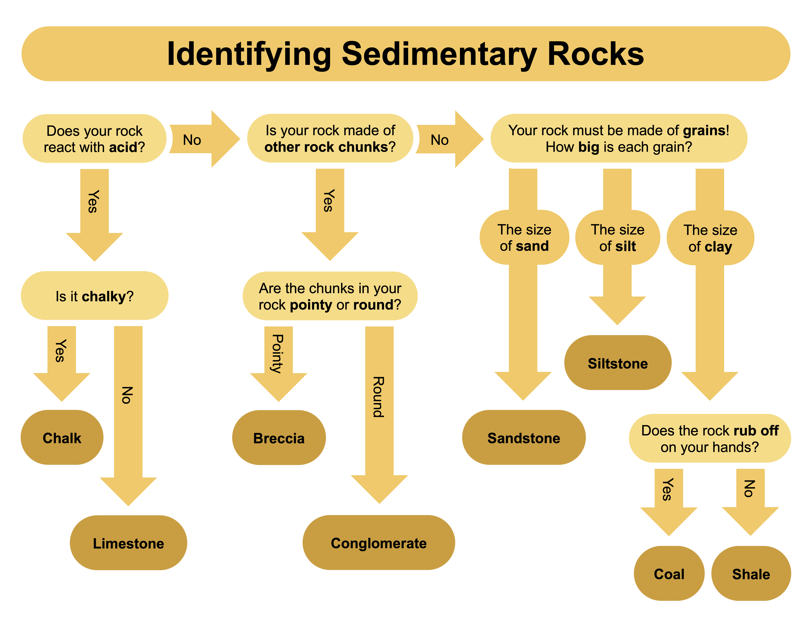

Slide 18
Sedimentary Rock Identification Activity
Sample # | Grain Size (clay vs silt vs sand vs gravel) | Grain Shape (angular or rounded) | Grain Sorting (good or poor) | Formation Environment | Energy Level (Low, Mid, High) | Rock Name
1 | Sand | Rounded | Good | Beach | Mid | Sandstone
Can provide word bank and/or partially filled in table to decrease difficulty for lower grade levels

